Slide 1
IAHR Young Professionals Networks
(IAHR-YPN)

Slide 2
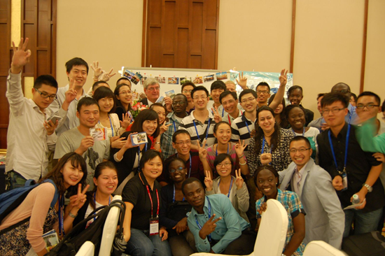
Aims
Through IAHR Young Professionals Networks, young professionals and students gather to share experiences, do special projects and take part in IAHR activities such as the biennial world congress and regional congresses.
Young Professionals Night at 35th IAHR World Congress in Chengdu 2013

Slide 3
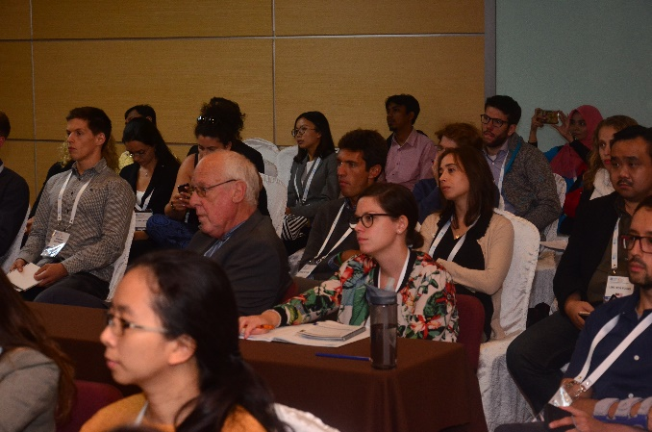
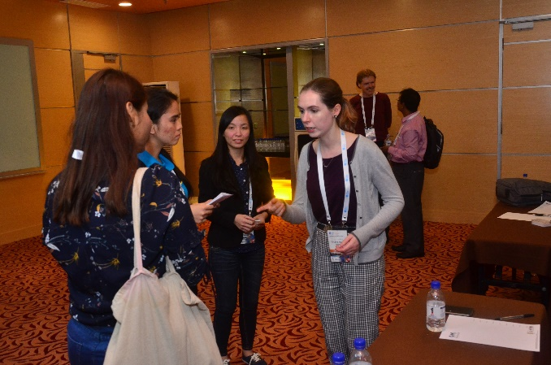
Activities
Research seminars, discussions or workshops
Field trips to visit local hydraulic works
Group research projects
Group trips to IAHR symposia, workshops and congresses
Informal collaborative activities with neighbouring Young Professionals Networks
Fundraising efforts to garner support for member participation in IAHR Congresses and other forums
Application to IAHR for hosting an IAHR Lectureship
Twinning
YPN Talk at the 37th World Congress in Kuala Lumpur in 2017

Slide 4
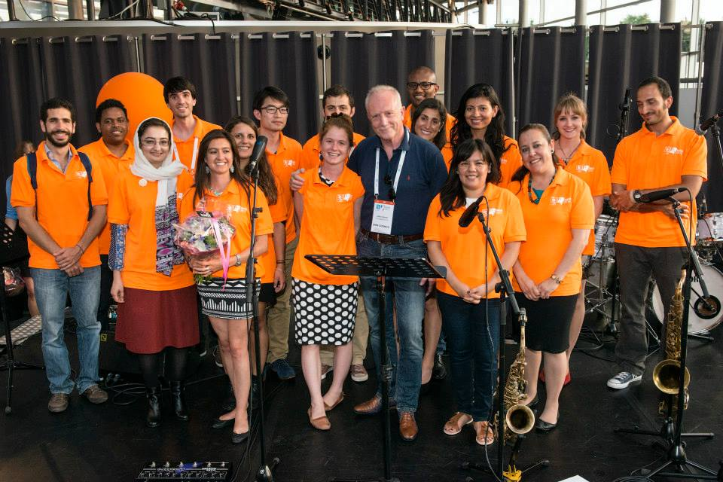
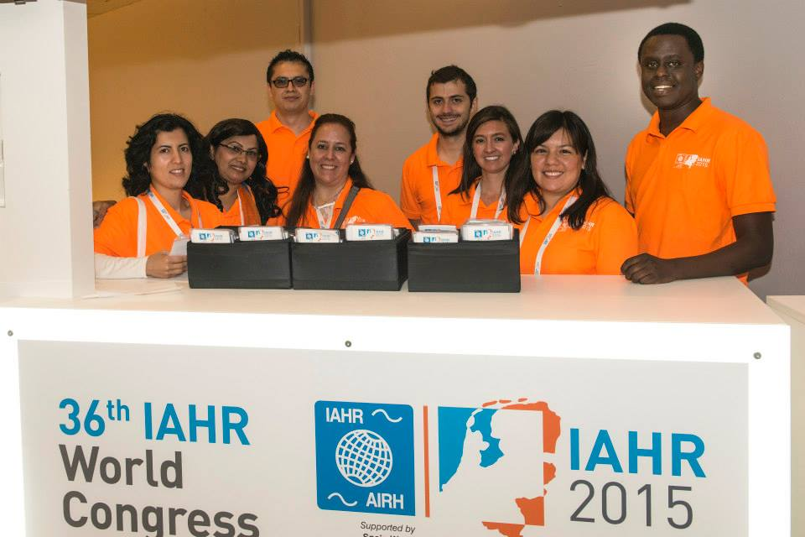
Activities
YPN Organizers from the 36th IAHR World Congress in Netherlands

Slide 5
Contact information
If you are interested in starting a new Young Professionals Network (YPN) or would like to contact details for another existing network, please contact Elsa Incio at elsa.incio@iahr.org
Find YPN on Facebook https://www.facebook.com/groups/IAHRYoungProfessionals

